Slide 1
MATLAB ASSIGNMENT
PREPARED BY GROUP 15

Slide 2
MEMBERS OF GROUP 15
NAME | REGISTRATION NUMBER | COURSE
Lugunga Timothy | BU/UG/2024/2679 | AMI
Bahemuka Godwins | BU/UG/2024/2583 | APE
Katusiime Joel | BU/UP/2024/1031 | WAR
Nabukwasi Shakira | BU/UP/2023/0862 | WAR
Naziwa Patricia | BU/UP/2024/0993 | PTI
Sidenya Kevin | BU/UP/2O24/3839 | WAR
Odong Eric Perry | BU/UP/2024/1059 | WAR
Nandijja Laila | BU/UP/2024/3833 | WAR
Namata Lilian Kizza | BU/UP/2024/0984 | MEB
Buluma Daniel | BU/UP/2024/4323 | AMI

Slide 3
INTRODUCTION TO MATLAB
MATLAB, which stands for matrix laboratory, is a high-performance programming language and environment designed primarily for technical computing
The first version of MATLAB was created in Fortran in the late 1970s as a simple interactive matrix calculator. This early iteration was built on top of two significant mathematical libraries: LINPACK and EISPACK, which were developed for numerical linear algebra and eigenvalue problems, respectively.
MATLAB was officially launched as a commercial product in 1984 by MathWorks, a company founded by Moler along with Jack Little and Steve Bangert. The software was reimplemented in C, with the addition of user-defined functions, toolboxes, and graphical interfaces.
Recent versions of MATLAB have introduced features like the Live Editor, which allows users to create interactive documents that combine code, output, and formatted text. This evolution reflects MATLAB's ongoing adaptation to meet the needs of its diverse user base across academ

Slide 4
PART A
We discussed the various numerical methods and we were able to formulate a flowchart which guided us on how to do different numerical methods utilizing the knowledge of algorithm development and control structures.
The methods we used include ;Newton Raphson Method, secant method, bisector method and fixed point iteration method.
We came up with two equation problems to solve using each of the numerical methods. These are; 1. f(x) = x^3-x-2
2. f(x) = x^3+x-1

Slide 5
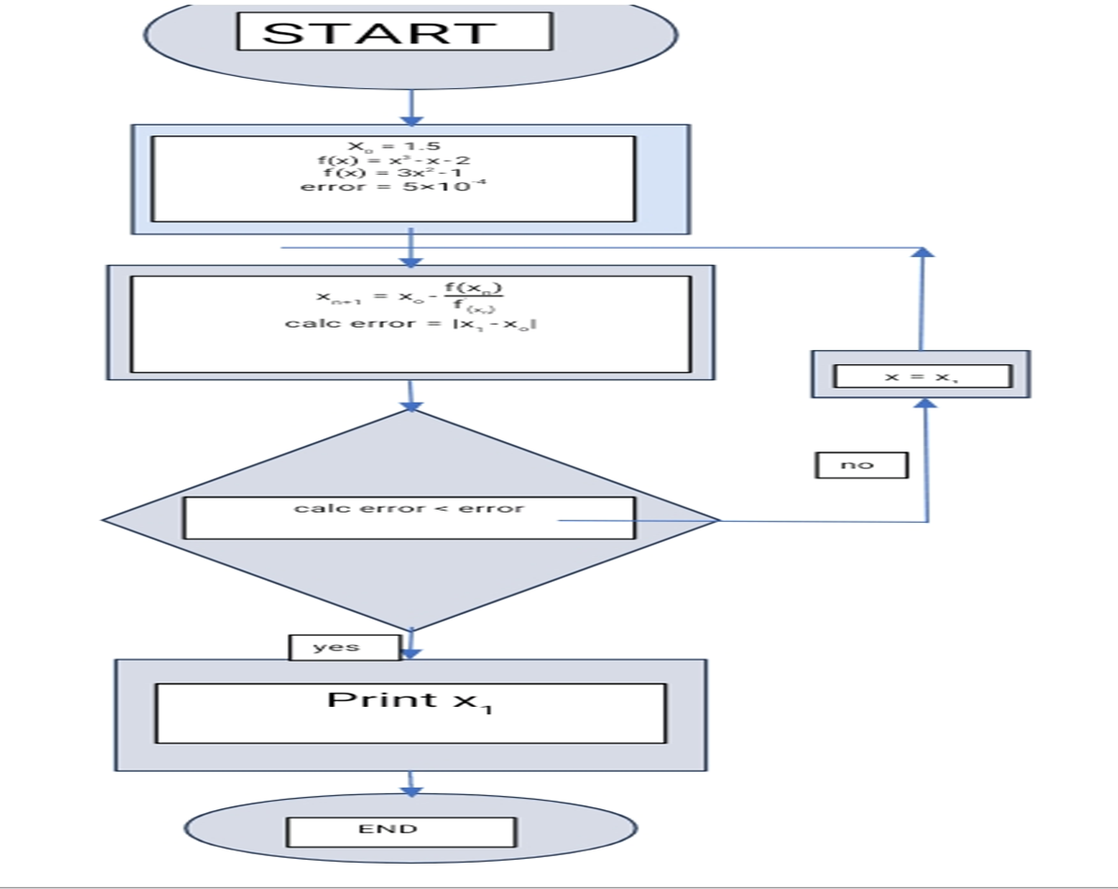
FLOW CHART

Slide 6
NEWTON RAPHSON METHOD
PROCEDURE
Start timer
Set initial guess X0
Define function f(x)
Define derivative df(x)
Set tolerance err = 0.0005
Compute first Newton – Raphson update:
X = x0 – f(x0)/df(x0)
Compute error = |x – x0|
While error>tolerance
Update x0 = x
Compute next newton – Raphson update:
X = x0 – f(x0)/df(x0)
Compute error = |x – x0|
End loop
Record final root value x
Stop timer and record time taken
Compute high – precision reference root xref using fzero
Save variables(x, time taken, xref) into file “Newton- Raphson . Mat”.

Slide 7
CONT.
EXAMPLE ONE
tic;
x0 = 2;
f = @(x0) x0^3 - x0 - 2;
df = @(x0) (3*x0^2)-1;
err = 0.0005;
x = x0-(f(x0)/df(x0))
x = 1.6364
calc_err = abs(x-x0);
while calc_err>err
x0 = x;
x = x0-(f(x0)/df(x0))
calc_err = abs(x-x0);
end
x = 1.5304
x = 1.5214
x = 1.5214
timetaken = toc
timetaken = 0.1385
xref = fzero(@(x0) x0^3 - x0 - 2,1.6);
save("Newton-Raphson.mat","x","timetaken","xref");

Slide 8
CONT.
x = 0.7500
x = 0.6860
x = 0.6823
x = 0.6823
timetaken = toc
timetaken = 0.0540
xref = fzero(@(x0) x0^3 + x0 - 1,1);
save("Newton-Raphson_2.mat","x","timetaken","xref");
EXAMPLE TWO
tic;
x0 = 0;
f = @(x0) x0^3 + x0 - 1;
df = @(x0) (3*x0^2)+1;
err = 0.0005;
x = x0-(f(x0)/df(x0))
x = 1
calc_err = abs(x-x0);
while calc_err>err
x0 = x;
x = x0-(f(x0)/df(x0))
calc_err = abs(x0-x);
end

Slide 9
SECANT METHOD
PROCEDURE
Start timer
Set initial guesses x0=1 x1=2
Define function f(x)
Compute slope(approx. derivative)between(x0,f(x)) and (x1,f(x1)):
Compute first update x=x1-f(x)/df
Compute error =|x-x1|
While error >tolerance (0.0005):Update x1=x
Update x1=x
Recompute slope df=(f(x1)-f(x0))/(x1 –x0)
Compute next update:
x=x1-f(x)/df
Update error = |x-x1|
End loop
Record final root value x
Stop timer and record time taken
Compute high precision reference root xref using fzero
Save variables(x,timetaken,xref) into file “secant method”

Slide 10
CONT.
EXAMPLE ONE
tic;
x0 = 1;
x1 = 2;
f0 = @(x0) x0^3 - x0 - 2;
f = @(x1) x1^3 - x1 - 2;
df = @(x1) (f(x1)-f0(x0))/(x1-x0);
err = 0.0005;
x = x1-(f(x1)/df(x1))
x = 1.3333
calc_err = abs(x-x1);
while calc_err>err
x1 = x;
x = x1-(f(x1)/df(x1))
calc_err = abs(x-x1);
end
x = 1.6429
x = 1.4606
x = 1.5565
x = 1.5026
x = 1.5318
x = 1.5157
x = 1.5245
x = 1.5197
x = 1.5223
x = 1.5209
x = 1.5217
x = 1.5212
timetaken = toc
timetaken = 0.0812
xref = fzero(@(x0) x0^3 - x0 - 2,1.6);
save("Secant.mat","x","timetaken","xref");

Slide 11
CONT.
EXAMPLE TWO
tic;
x0 = 0;
x1 = 1;
f0 = @(x0) x0^3 + x0 - 1;
f = @(x1) x1^3 + x1 - 1;
df = @(x1) (f(x1)-f0(x0))/(x1-x0);
err = 0.0005;
x = x1-(f(x1)/df(x1))
x = 0.5000
calc_err = abs(x-x1);
while calc_err>err
x1 = x;
x = x1-(f(x1)/df(x1))
calc_err = abs(x-x1);
end
x = 0.8000
x = 0.6098
x = 0.7290
x = 0.6530
x = 0.7011
x = 0.6705
x = 0.6899
x = 0.6775
x = 0.6854
x = 0.6804
x = 0.6836
x = 0.6815
x = 0.6828
x = 0.6820
x = 0.6825
x = 0.6822
timetaken = toc
timetaken = 0.1129
xref = fzero(@(x0) x0^3 + x0 - 1,1);
save("Secant_2.mat","x","timetaken","xref");

Slide 12
BISECTOR METHOD
Set approximate root x = (a + b) / 2
Stop timer and record timetaken
Compute high-precision reference root xref using fzero
Save variables (x, timetaken, xref) into file "Bisection.mat"
PROCEDURE
Start timer
Define function f(x)
Set initial interval [a, b]
Set tolerance err = 0.0005
While (b - a) > err:
Compute midpoint c = (a + b) / 2
If f(a) * f(c) < 0:
Root lies in [a, c], so set b = c
Else:
Root lies in [c, b], so set a = c
End loop

Slide 13
CONT.
x = (a+b)/2
x = 1.5212
timetaken = toc
timetaken = 0.0491
xref = fzero(@(x) x^3 - x - 2,1.6);
save("Bisection.mat","x","timetaken","xref");
EXAMPLE ONE
tic;
f = @(x) x^3 - x - 2;
a = 1;
b = 2;
err = 5e-4;
while (b-a)>err
c=(a+b)/2;
if f(a)*f(c)<0
b = c;
else
a = c;
end
end

Slide 14
CONT.
x = (a+b)/2
x = 0.6824
timetaken = toc
timetaken = 0.1038
xref = fzero(@(x) x^3 - x - 2,1);
save("Bisection_2.mat","x","timetaken","xref");
EXAMPLE TWO
tic;
f = @(x) x^3 + x - 1;
a = 0;
b = 1;
err = 5e-4;
while (b-a)>err
c=(a+b)/2;
if f(a)*f(c)<0
b = c;
else
a = c;
end
end

Slide 15
FIXED POINT ITERATION METHOD
Compute error = |x - x0|
Append x to iteration list
End loop
Record final root value x
Stop timer and record timetaken
Compute high-precision reference root xref using fzero
Save variables (x, timetaken, xref) into file "Fixed_point_iteration.mat
PROCEDURE
Start timer
Define function f(x)
Rearrange into x = g(x
Set initial guess x0
Set tolerance err = 0.0005
Initialize iteration list x_hist with x0
Compute first iterate:
x = g(x0)
Compute error = |x - x0|
While error > tolerance:
Update x0 = x
Compute next iterate:
x = g(x0) "

Slide 16
CONT.
EXAMPLE ONE
tic;
f = @(x) x^3 - x - 2;
g = @(x) (x+2).^(1/3);
x = 1;
err = 5e-4;
while true
x1 = g(x);
if abs(x1-x)<err
break
end
x = x1
end
x = 1.4422
x = 1.5099
x = 1.5197
x = 1.5211
timetaken = toc
timetaken = 0.0500
xref = fzero(@(x) x^3 - x - 2,1.6);
save("Fixed_point_iteration.mat","x","timetaken","xref");

Slide 17
CONT.
EXAMPLE TWO
tic;
f = @(x) x^3 + x - 1;
g = @(x) (1-x).^(1/3);
x = 0.5;
err = 5e-4;
while true
x1 = g(x);
if abs(x1-x)<err
break
end
x = x1
end
x = 0.7937
x = 0.5909
x = 0.7424
x = 0.6363
x = 0.7138
x = 0.6590
x = 0.6986
x = 0.6704
x = 0.6907
x = 0.6763
x = 0.6866
x = 0.6792
x = 0.6845
x = 0.6807
x = 0.6835
x = 0.6815
x = 0.6829
x = 0.6819
x = 0.6826
x = 0.6821
timetaken = toc
timetaken = 0.0755
xref = fzero(@(x) x^3 + x - 1,1);
save("Fixed_point_iteration_2.mat","x","timetaken","xref");

Slide 18
GROUPING DATA FOR PLOTTING
Define list of methods = [Newton-Raphson, Secant, Bisection, Fixed Point]
Define list of problems = [Example1, Example2]
Initialize empty table for computation times
For each problem in problems:
Open new figure
For each method in methods:
Load the saved data file for this method and problem
Extract iterates (x), true root, and time
Compute error at each iteration = |x - true root|
Plot error vs iteration
Store time in the times table
Show legend and set Y axis to log scale
Open new figure
Make bar chart of computation times for all methods and both problems
Label axes and add title

Slide 19
PLOTTING CODE
% plotting script
methods = {'Newton-Raphson','Secant','Bisection','Fixed_point_iteration'};
problems = {'','_2'};
times = zeros(length(methods), length(problems));
for p = 1:2
figure; hold on;
title(['Error vs Iterations for Example ', num2str(p)]);
xlabel('Iteration'); ylabel('Error');
for m = 1:4
filename = [methods{m}, problems{p}, '.mat'];
load(filename, 'x', 'timetaken', 'xref');
err = abs(x - xref);
plot(0:length(err)-1, err, 'DisplayName', methods{m});
times(m,p) = timetaken;
end
legend show;
set(gca,'YScale','log'); % log scale for clarity
end
figure;
bar(times);
set(gca,'XTickLabel',methods);
xlabel('Methods'); ylabel'Time (s)');
legend('Example 1','Exampl (e 2');
title('Computation Times');

Slide 20
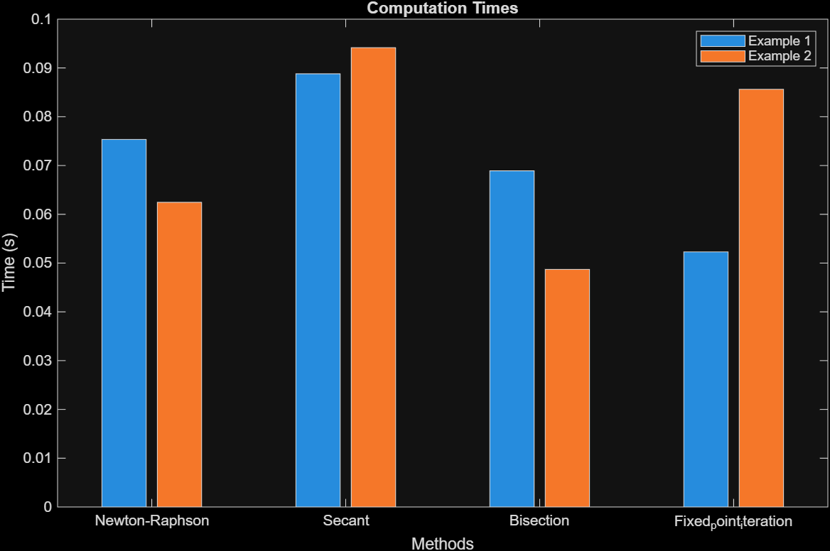
GRAPH OF COMPUTATION TIME AGAINST NUMERICAL METHODS
For each method and problem:
plot error vs iteration curve
use log scale for error axis
After looping
create bar chart comparing computation time with different numerical methods
GRAPH OF TIME AGAINST METHODS

Slide 21
PART B
We applied different differential equations namely ; Euler and range Kutta method.
We formulated two real world problems which we solved using these methods.
The real world problems are ;
-Finding the motion of a falling object with air resistance
-Cooling a hot metal rod

Slide 22
RANGE KUTTA METHOD
REAL WORLD PROBLEM ONE
% Runge-Kutta Method of order 2
% general formula for Runge-Kutta Method of order 2
%k1 = h*f(tn,yn);
%k2 = h*f(t(n+1),y(n)+k1);
%y(n+1) = y(n) + (1/2)*(k1 + k2);
% example one: motion of a falling object with air resistance satisfying
% the equation dv/dt = 9.8 - 0.2*v, v(0) = 0
f = @(t,v)9.8-0.2*v;
t0 = 0;
v0 = 0 ;
h = 2 ;
tn = 50 ;
n = (tn - t0)/h;
t(1) = t0; v(1) = v0;
for i = 1:n
t(i+1) = t0 + i*h;
t(i+1) = t0 + i*h;
k1 = h*f(t(i),v(i));
k2 = h*f(t(i+1),v(i)+k1);
v(i+1) = v(i) + (1/2)*(k1 + k2);
fprintf('v(%.2f) = %.4f\n', t(i+1),v(i+1))
end
timetaken = toc;
disp(timetaken)
figure;
hold on
plot(t, v);
xlabel('Time (s)');
ylabel('Velocity (m/s)');
title('Velocity of the Ball Over Time');
grid on;

Slide 23
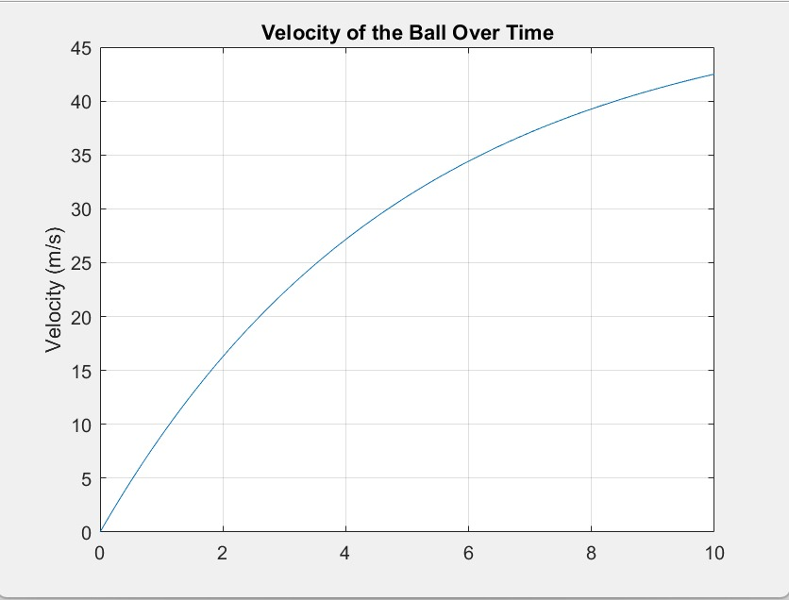
CONT.
A GRAPH OF VELOCITY AGAINST TIME

Slide 24
CONT.
t(i+1) = t0 + i*h;
k1 = h*f(t(i),T(i));
k2 = h*f(t(i+1),T(i)+k1);
T(i+1) = T(i) + (1/2)*(k1 + k2);
fprintf('T(%.2f) = %.4f\n', t(i+1),T(i+1))
end
timetaken1 = toc;
disp(timetaken1)
figure;
plot(t, T);
xlabel('Time (s)');
ylabel('Temperature (0C)');
title('cooling of a hot metal rod');
grid on;
REAL WORLD PROBLEM TWO
%% % Runge-Kutta Method of order 2
% general formula for Runge-Kutta Method of order 2
%k1 = h*f(tn,yn);
%k2 = h*f(t(n+1),y(n)+k1);
%y(n+1) = y(n) + (1/2)*(k1 + k2);
% Example two: cooling of a hot metal rod, following the equation dT/dt =
% -0.07(T-25)
f = @(t,T) -0.07*(T-25);
t0 = 0;
T0 = 200 ;
h = 10 ;
tn = 150 ;
n = (tn - t0)/h;
t(1) = t0; T(1) = T0;
for i = 1:n

Slide 25
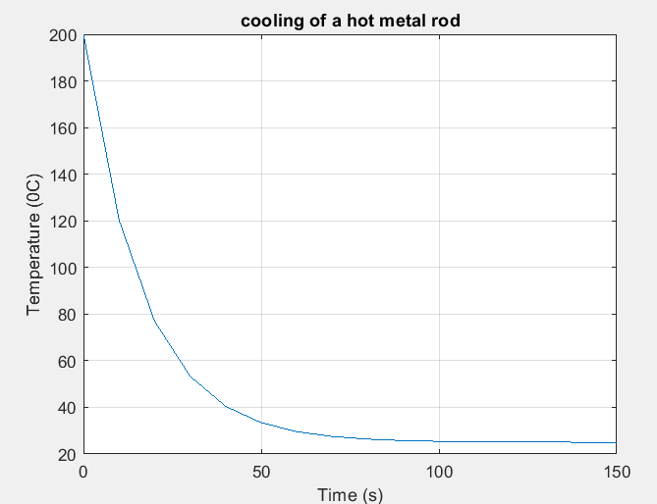
CONT.
A GRAPH OF TEMPERATURE AGAINST TIME

Slide 26
EULER METHOD
REAL WORLD PROBLEM ONE
% Parameters
m = 1; % mass of the ball (kg)
g =9.8; % gravitational acceleration (m/s^2)
k = 0.2; % drag coefficient
dt = 0.1; % time step (s)
t_end = 10; % total time (s)
% Initialization
t = 0:dt:t_end; % time vector
v = zeros(size(t)); % velocity vector
v(1) = 0; % initial velocity
% Start timing
tic% Number of steps
num_steps = length(t) - 1;
% Euler method
for i = 1:num_steps
dvdt = g - k*v(i); % compute the derivative
v(i+1) = v(i) + dvdt * dt; % update velocity
end
% Stop timing
computation_time = toc;
% Display computation time and number of steps
fprintf('Computation time: %.4f seconds\n', computation_time);
fprintf('Number of steps: %d\n', num_steps);
% Close extra figures if more than 10 are open
figHandles = findobj('Type', 'figure');
if length(figHandles) > 10
close(figHandles(1:end-10)); % Close the extra figures
end
% Plotting the results
figure;
plot(t, v);
('Time (s)');
ylabel('Velocity (m/s)');
title('Velocity of the Ball Over Time');
grid on;

Slide 27
CONT.
A GRAPH OF VELOCITY AGAINST TIME

Slide 28
CONT.
REAL WORLD PROBLEM TWO
% Parameters
T_initial = 200; % Initial temperature of the rod
T_env = 25; % Environment temperature
k = 0.07; % Cooling constant
dt = 0.1; % Time step
t_final = 60; % Total time for simulation
N = t_final / dt; % Number of time steps
% Preallocate arrays for time and temperature
time = zeros(1, N);
temperature = zeros(1, N);
% Initial conditions
temperature(1) = T_initial;
time(1) = 0;
% Start computation time
tic;
% Euler method for solving the differential equation
for n = 1:N-1
dT = -k * (temperature(n) - T_env); % Calculate the change in temperature
temperature(n+1) = temperature(n) + dT * dt; % Update temperature
time(n+1) = time(n) + dt; % Update time
end
% End computation time
elapsed_time = toc;
% Plotting the results
figure;
plot(time, temperature, 'LineWidth', 2);
xlabel('Time (seconds)');
ylabel('Temperature (Â°C)');
title('Cooling of the Rod Over Time');
grid on;
% Display computation time
fprintf('Computation time: %.4f seconds\n', elapsed_time);

Slide 29
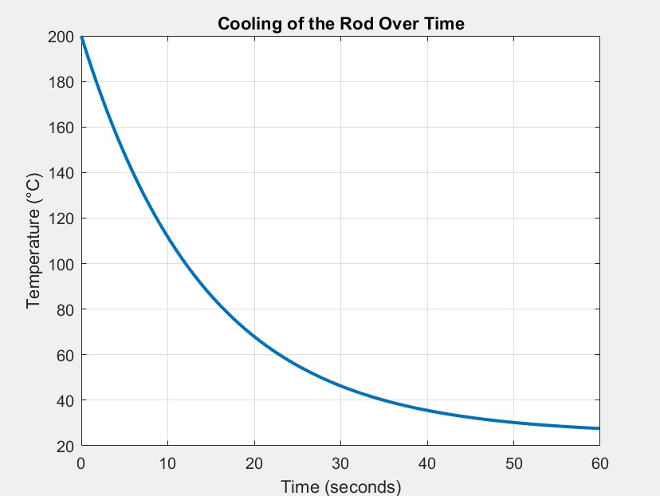
CONT.
A GRAPH OF TEMPERATURE AGAINST TIME

Slide 30
CONCLUSION
We managed to utilize the knowledge of algorithms development , control structures and concepts from modules 1 to 4 to explore numerical methods for finding solutions to functions and solving differential equations for real world problems. This showed the importance of choosing the right method considering accuracy, stability and computation time.

